Slide 1
ESTIMATE THE CROP YIELD USING DATA ANALYTICS

Slide 2
TEAM DETAILS
Simham TejSahan - SSNCE193002100 - Team Leader
D Jaswanth - SSNCE193002040 - Scrum Team
Tarini Shankar - SSNCE193002108 - Scrum Team
Vignesh S - SSNCE193002116 - Scrum Team

Slide 3
Problem Statement
Crop production in India is one of the most important sources of income and India is one of the top countries to produce crops.
As per this project we will be analyzing some important visualization, creating a dashboard and by going through these we will get most of the insights of Crop production in India.

Slide 4
Proposed Solution
To deliver a perfectly analyzed Dashboard of historical agricultural production data from several Indian states so that farmers may forecast their crop yield.
To create a webpage where the dashboard, Report and Story created in IBM Cognos are embedded and user can login to the webpage to access the content.
Also, a predictive model is created to estimate the Crop production using various features using different ML algorithms.

Slide 5
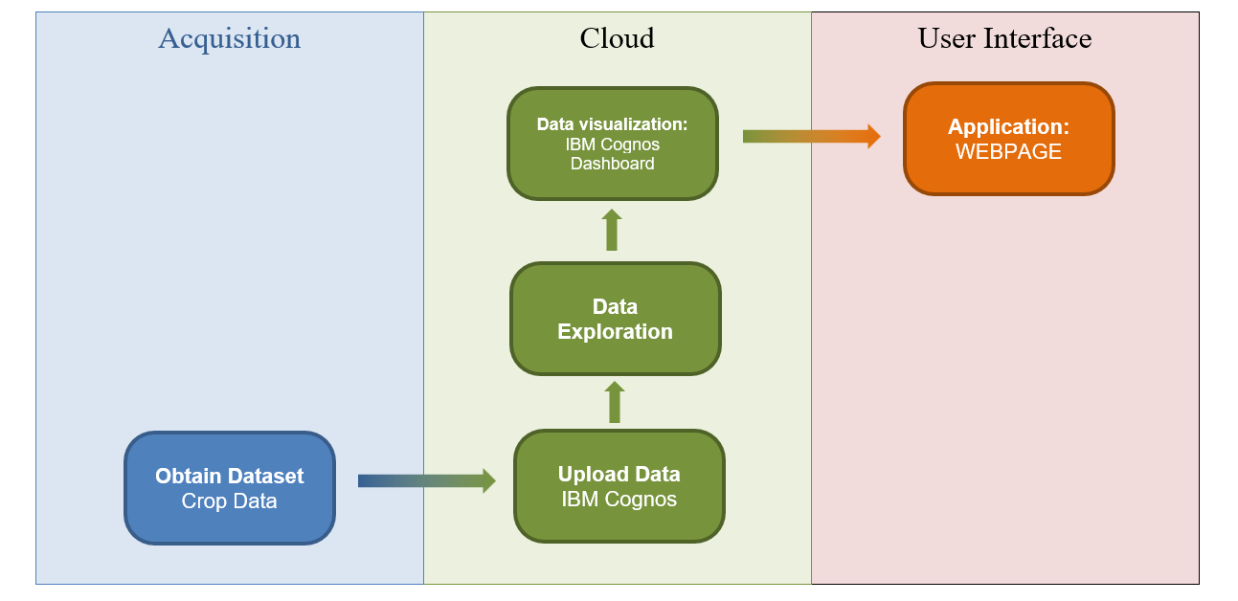
Technical Architecture

Slide 6
Working Demo of the Project
WEBPAGE link
https://crop-yield-data-analytics.s3.ams03.cloud-object-storage.appdomain.cloud/Estimate-crop-yield/login%20Page.html

Slide 7
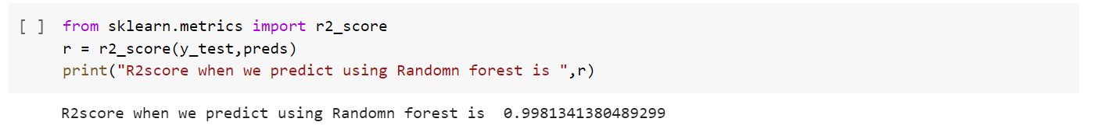
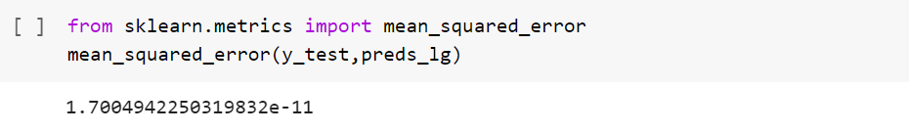
Performance Metrics(Results)
Random Forest Model - R2 score
Linear Regression – Mean Squared Error

Slide 8
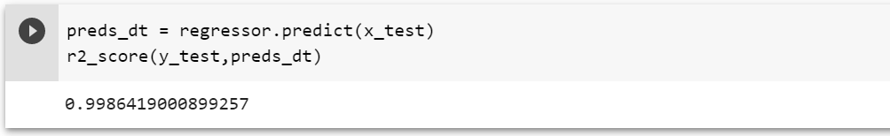
Performance Metrics(Results)
Decision Tree – R2 score

Slide 9
Scalability/ Future Scope
Lot of steps were involved in the data visualization and creation of dashboard. It would be much more convenient and efficient to identify the target attribute only, hence reducing the computational work. There should also be a proper algorithm selection process.
This can be scaled up to more number of users to analyze and estimate the crop production in India.

Slide 10
THANK YOU

